Slide 1
Magnetism, Laser Fundamentals and
Opto Electronics

Slide 2
Nano magnets
Nanomagnets are ferromagnetism where the magnetic domains are aligned in one dimension .
The magnetic dipoles are of nano scale length (10-9m) and are synthesized in different shapes such as dots (Quantum), pillars, wires, tubes, rods, chains, granules etc.
Ferromagnetic material exhibit permanent magnetic dipole moment and it produces a spontaneous magnetization(even for a small external magnetic field).
Based on process method, nanomagnets are classified as:
Particulate nanomagnets
Geometrical nanomagnets

Slide 3
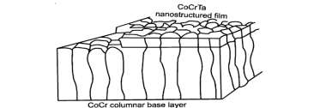
Particulate nanomagnets
They are granular solids with one or more phases having magnetic properties. There are two methods that make use of the rapid solid technique.
In one method, amorphous phase material is first obtained and then it is subjected into necessary heat treatment to get the nano structure.
In the second method, the molten melt is first transferred into the block and then it is cooled slowly to obtain the nano structure.
In this process, the nanomagnetic material properties can be changed from softest to the hard magnetic state (i.e. low coercivity and anisotropy to high coercivity and Anisotropy)
Layered structure consists of Functional Layer and Seed Layer. Seed layer is first grown with close packed direction with small size grains of CoCr. The functional layer is grown over the textural seed layer with nanostrucural phase of CoCrTa as shown in Fig.

Slide 4
Geometrical Nanomagnets
SELF ASSEMBLY
In lithography, a mask is formed on a polymer resist. A pattern of magnetic islands is retained after etching or lift off. On a template of base material, nanoparticles are self assembled through surfactant and ligand structures cover larger surface area.
The ligand lengths control the spacing between the nanoparticles. Here again, the energy product is very high.
In the case of „shape anisotropy‟ where magnetic particles are of normal structure along the field direction and are elongated in a direction to that of the applied field.
This shape anisotropy factor is not a desirable one and for this reason AlNiCo which is a Geometrical nanomagnet are not considered to be important as that of NdFeB which is a particulate nanomagnet.

Slide 5
Magnet Resistance
Concepts used in nano devices
Ordinary magneto resistance (OMR)
Giant magneto resistance (GMR)
Tunneling magneto resistance (TMR)

Slide 6
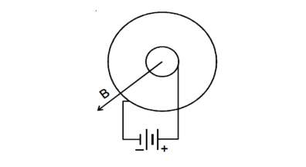
Ordinary magneto resistance (OMR)
It is the property of the material to change the value of its electrical resistance by less than 5% change under the influence of an external magnetic field.
It was first discovered by William Thomson in 1856.
This can be explained by considering corbino disk as in Fig.(Corbinodisc). It consists of a two concentric annular rings with perfectly conducting rims.
A battery drives the current between the rims, in the absence of external magnetic field. When a magnetic field is applied, a Lorenz force drives a circular component of current, thus increasing the resistance between inner and outer rims and this resistance is called as magnetic resistance.

Slide 7
Giant Magneto Resistance (GMR)
This giant magneto resistive effect was first discovered by the two European researchers, Peter Gruenberg and Albert Fert in the late 1980s and in the year 2007, Nobel prize in Physics was awarded to them for the discovery of GMR.
Here, the change in electrical resistance is very large compared to other magnetic sensors (where it is only few percent, say 2% to 6%).
It is named as giant not because of the size of the device, but for the quantum mechanical magneto resistance effect that leads to large change in electrical resistance in thin layers of magnetic materials.
GMR refers to hard disc drive storage technology.

Slide 8
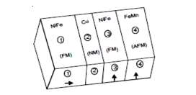
GMR device (or) GMR heads
GMR sensor (or) spin valve
GMR sensor (or) head (or) device is used to read/write data in a hard disc, by making use of GMR technique.
FM-Ferromagnetic
AFM---Anti Ferromagnetic
NM---Non Magnetic
Fig. 3.25 Structure of GMR

Slide 9
GMR sensor is made up of 4 layers namely,
(i) free layer (ii) spacer (iii) pinned layer (iv) pinning layer
these layers combine into a single structure.
(i) Free layer :It is the sensing layer of ferromagnetic material and is passed over the surface of the data bits to be read. It is free to rotate in response to the magnetic patterns on the disc. (NiFe) or cobalt.
(ii) Spacer: It is made up of thin layer of non-magnetic metal layer usually made from copper that separates the magnetization of free and pinned layers.
(iii) Pinned layer: A layer of a fixed magnetic orientation by its proximity to the pinning /exchange layer. (Cobalt or / NiFe).
(iv)Pinning (or) Exchange Layer: A layer of strong antiferromagnetic that fixes the pinned layer's magnetic orientation (FeMn).

Slide 10
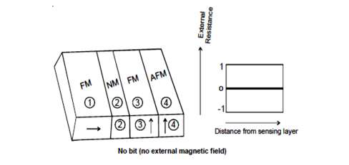
Working / Mechanism of GMR
The GMR sensor is designed in such a way that it would operate at room temperature and at weak external magnetic field. Here the weak external magnetic field refers to the field due to the bit (1 or 0) on the hard disk that contains up or down spin of the electron.
The following sequence depicts the activity inside a GMR sensor.
Case1: Under no external magnetic field (ie) when there is no bit beneath the GMR sensor. Here the resistance offered is zero as shown in the graph (Fig).
Case1: No external magnetic field

Slide 11
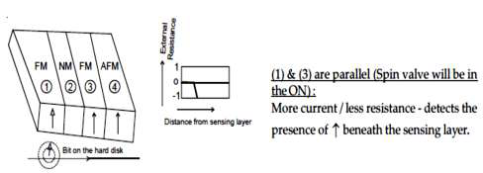
Case 2 : As the bit travels exactly under GMR sensor i.e., now the sensing layer is under the weak external magnetic field.
Hence the spin alignment of two adjacent (sensing layer and pinned layer) layers become parallel.
Hence the electron spin easily passes through both the layers. Since, here the
scattering is very low, the total resistance is very small (shown in the Fig.)

Slide 12
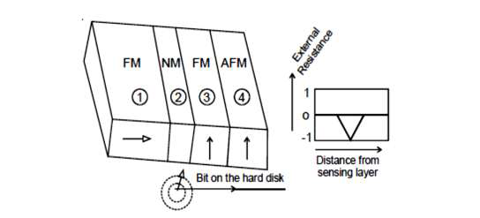
Case 3 : As the bit travels away from the GMR sensor
Here the sensing layer will try to orient its spin in a direction opposite to that of the pinned layer. Hence the resistance increases as shown in the graph.
Fig. Bit travels away from the GMR sensor

Slide 13
Note: It can be compared to a case when the polarizer &analyzer are not aligned parallel to each other and hence the light is blocked.
(i.e.) when the total resistance is high, it detects the absence of beneath it. When the total resistance is comparatively less, it detects the presence of .
If the layers are not of proper thickness, however coupling mechanism can destroy the GMR effect; hence the layer's thickness should be optimum and they should be thinner, say several nm than the mean free path of electrons.

Slide 14
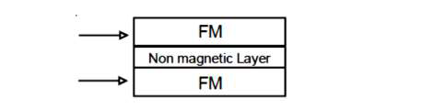
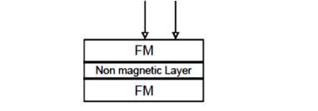
External magnetic field can be applied in two ways.
Current is parallel to the plane of layers (CIP) - it offers higher resistance.
Current is perpendicular to the plane of the layers (CPP) - it offers only less resistance.

Slide 15
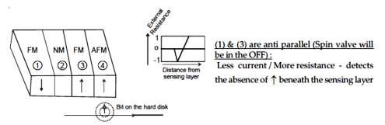
Case 4: As the bit travels far away from the sensing layer of the GMR sensor.
Here, the sensing layer's spin orientation becomes exactly opposite to that of the pinned layer (i.e.) the spin alignment of sensing layer and pinned layer becomes anti parallel (Fig.).
Fig. Bit travels far away from the sensing layer

Slide 16
Tunneling Magneto Resistance (TMR)
Tunneling Magneto Resistance is the drastic change of tunneling current that passes through a very thin insulating layer which is sandwiched between two ferromagnetic (FM) layers, due to relative changes in the alignment of magnetization of the two ferromagnetic layers.
Magnetic Tunneling Junction (MTJ)
It is a device used to read / write data in a non volatile computer memory, namely Magneto Resistive Random Access Memory (MRAM) using TMR technique.

Slide 17
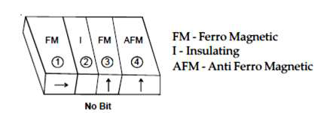
Structure of TMR device / structure of MTJ
It is very similar to that of GMR device, with the change that here the spacer is a thin insulating layer. It has four layers namely (Structure of MTJ is shown in Fig.).
  1. Sensing layer (Co)
  2. Spacer (Al2O3/MgO)
  3. Pinned layer (Co)
  4. Pinning layer (IrMn)

Slide 18
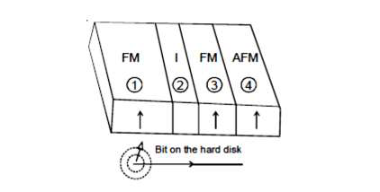
Mechanism
Consider the Magnetic Tunneling Junction, when no voltage is applied to the junction, electrons tunnel in both directions with equal rates.
Under a bias voltage, electrons tunnel preferentially to the positive electrode.
When the bit of hand disk / CD, passes beneath the sensing layer (1) the spin orientation of the sensing layer rotates relative to that of the pinned layer (3).
Fig. The spin orientation of sensing layer and pinned layers are parallel to each
other as in Fig.

Slide 19
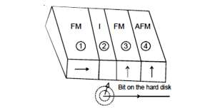
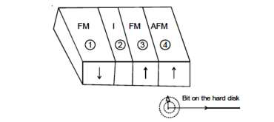
Hence large current tunnels through the insulating layer and lowers the overall resistance. Here the spin flip scattering length should be greater than the barrier width to tunnel across the barrier.
When the bit moves away, the spin orientation of sensing layer (1) becomes anti parallel with that of pinned layer (3) (Fig.3.28d). Here both spin-up and spin down orientations will encounter a bottleneck in either of the two films.
Therefore less empty states will be available in (3) for the spin-down of (1). Similarly less spin-up electrons are available in (1) which will occupy the empty states of (3).
Hence the current is small, leading to high total resistance.

Slide 20
Difference between GMR and TMR
Even though both GMR and TMR act as a spin valve, the mechanism used for spin filtration is quite different in these two techniques
GMR | TMR
If filters one spin polarization over another due to the changes in the spin characteristics of the sensing layer, in an external magnetic field. | If allows both majority and inorityspins due to changes in the tunneling current that occurs due to change inalignment of spins in an external magnetic field.
Structures: 4 layers (i) Sensing layer (ii) Spacer - non magnetic- conducting layer (iii) Pinned – Layer (iv) Pinning Layer | Structures : 4 layers (i) Sensing layer (ii) Spacer - insulating layer. (iii) Pinned Layer (iv) Pinning Layer
Change in electrical resistance typically about 50%, which is large compared to ordinary magneto resistance where the change is only about 2% to 6%. | Change in electrical resistance is larger than GMR by a factor of 10.

Slide 21
GMR | TMR
Spin orientation is not conserved. | During tunneling, spin orientation Is conserved.
This technique do not lead to recording of data in disk drives. | This techniques allows for recording of data in disk drives, thereby increasing the density of data's stored in the given area; it exceeds 1 Tera byte/(inch)2.
It is a hard disk drive storage technology. | It has led to the emergence of Magneto Resistive Random Access Memory (MRAMs) and reprogrammable magneto logic devices. MRAM - is a new type of non-volatile memory.

Slide 22
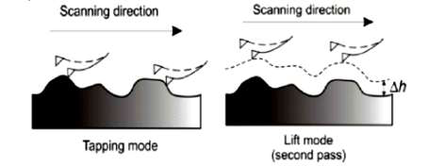
Probing Nanomagnetic Materials
Fig. Principle of MFM

Slide 23
Magnetic Force Microscopy (MFM) uses a combination of Tapping Mode, Lift Mode (Fig.) and a magnetized tip to gather information about the magnetic field above a sample.
This topographic information is stored and retraced with a height offset in Lift Mode, and the magnetic data is then collected.
Designed for magnetic force microscopy, these conical-tipped high aspect ratio AFM probes yield a very high force sensitivity and feature a magnetic coating (available in various thicknesses) covering the cantilever and tip.

Slide 24
PPP(Point Probe Plus)-MFMR AFM probe is our standard probe for magnetic force microscopy providing a reasonable sensitivity, resolution and coercivity. It has proven stable imaging of a variety of recording media and other samples.
The hard magnetic coating on the tip is optimized for high magnetic contrast and high lateral resolution of considerably better than 50 nm.
PPP-LC-MFMR AFM probe is coated with a soft magnetic thin film enabling the measurement of magnetic domains in soft magnetic samples.
PPP-LM-MFMR AFM probe is designed for magnetic force microscopy with reduced disturbance of the magnetic sample by the tip and enhanced lateral resolution - compared to the standard PPP-MFMR probe.

Slide 25
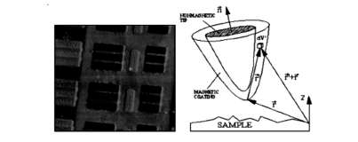
SSS-MFMR AFM probe is optimized for high resolution magnetic force imaging. The Super Sharp Silicon tip basis combined with a very thin hard magnetic coating result in an extremely small radius of the coated tip and a high aspect ratio at the last few hundred nanometers of the tip the essential demands for high lateral resolution down to 20 nm in ambient conditions.
When the AFM tip is coated with a magnetic material shown in Fig. then the AFM can also measure and create maps of the magnetic structure and characteristics of the sample surface.
Fig. MFM tip having a magnetic coating on a non-magnetic core

Slide 26
Hard Disk Drive Technology
Bonded Magnets
Isotropic powders are most commonly used for the production of bonded magnets. Four RE powder families are commercially used:
(i) isotropic and anisotropic nanostructured Nd-Fe-B, ribbons,
(ii) "lean neo" Nd2Fe14B/Fe/Fe3Bn and composites,
(iii) SmCo5 and Sm2Co17and finally
(iv) Sm-Fe-N.
Finally it is realized that hard nano structured materials could find applications as high density recording media. Especially used in the fields of magnetic recording, sensors, logic systems, MRAM and spin-electronics.

Slide 27
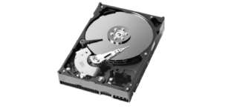
Recording Media
The media consist of films of typical thickness below 50 nm, themselves made of hard magnetic nanoparticles embedded in a non-magnetic matrix.
FePt and CoPt films are good candidates for this type of applications, since high corrosion resistance is needed additionally.
Fig. Hard Disk

Slide 28
Direct and Indirect Bandgap
The electrical properties of a solid material are a consequence of its electron band structure, (i.e.) the arrangement of the outermost electron bands and the way in which they are filled with electrons.
The energy corresponding to the highest filled state at zero Kelvin is called the Fermi Energy (EF). This represents the top-most filled electron energy state of the given material at zero Kelvin.
For semiconductors, all the states in the valence band are completely filled with electrons and there is no overlap between the valence band and the empty conduction band. This gives rise to a narrow energy band gap (<2eV) between the valence band and conduction band. The EF lies within the band gap (Fig).

Slide 29
Direct Bandgap
In direct band gap semiconductors (Fig), the conduction band minimum (Ec) and valence band maximum (Ev) energy occur at the same value of momentum K. Hence, it is possible for direct recombination of electron and hole, emitting a ligh photon of energy h. This type of light emission is not possible in indirect band gap semiconductors.
Life time or recombination time of charge carriers is very less. Direct band gap semi conductor devices have much higher internal quantum efficiency.
They are used to fabricate LED and Laser Diode.

Slide 30
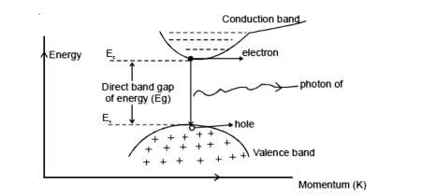
Direct band gap semiconductor

Slide 31
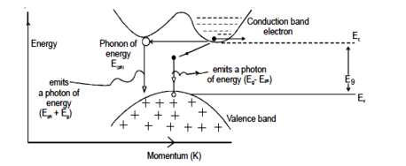
Indirect Bandgap
Indirect band gap semiconductor

Slide 32
For indirect band gap semiconductors the conduction band minimum and the valence band maximum occur at different values of momentum.
To perform band-to-band recombination and to conserve momentum, it must involve a third particle called phonon (crystal lattice vibration), since the photon momentum is very small.
Due to longer life time of charge carriers, they are used to fabricate the rectifier diodes and transistors which are used to make switches and integrated circuits.
Quantum well, quantum wire and quantum dot are nothing but nanostructured semi conductors. The electronic characteristics of these nanostructured semiconductors are closely related to the size and shape of the individual crystal.
These quantum wells, wires and dots are generally grown by advanced epitaxial techniques such ion implantation, state - of - the - art lithographic techniques, etc.,

Slide 33
LASER
LASER : Light Amplification by Stimulated Emission of Radiation.
Let us see the basic keywords used in lasers.
Conditions for laser action
Population inversion
Optical Pumping
Spontaneous emission and stimulated emission
Active Medium

Slide 34
Conditions for Laser Action
Laser action means the amplification of light by stimulated emission of radiation. To get laser action, it is necessary to have,
(i) Stimulated emission.
(ii) There should be population inversion of atoms.
(iii) There should be a stimulating photon.

Slide 35
Population inversion
Stimulated emission of light can be produced through maintaining the population inversion, where there will be more number of atoms unit volume (N2) in the higher energy level (E2) than the other lower energy level (say E1) between which the lasing action takes place; let N1represents the number of atoms / unit volume in E1.
Then, Population Inversion represents E2 >E1 and N2 >N1which is possible under non-thermal equilibrium by pumping the atoms from lower energy level to higher energy level.

Slide 36
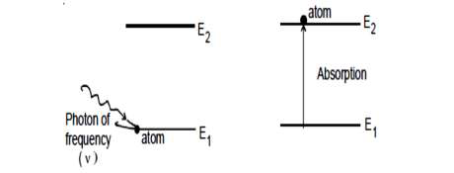
Optical Pumping
The atoms in the lower energy level E1 are made to go to the upper energy level
E2 by pumping technique, where, by absorbing a photon of frequency  = (E2 - E1 )/h, the atom in lower energy level E1, goes to the upper energy level E2.
The rate of absorption depends on the number of atoms present in the level E1 and density of photons in the system (Fig).
Different pumping techniques such as optical pumping, chemical pumping, etc are available.

Slide 37
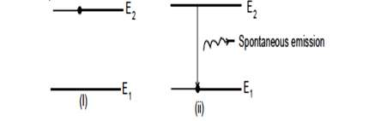
Spontaneous emission
In spontaneous emission (Fig.), the atom in energy level E2 make the transition to the lower energy level E1 spontaneously without the help of any external agent and it emits a photon whose energy is equal to (E2-E1).
The rate of emission depends on the number of atoms present in the higher energy level. Characteristics of photons emitted by spontaneous emission are polychromatic radiation, low intensity, incoherent, large divergence.

Slide 38
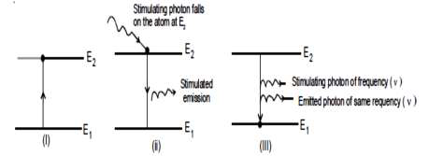
Stimulated emission
In stimulated emission (Fig.3.38), the atom in higher energy level E2 can make a transition to the lower energy level E1 with the help of an external photon of frequency, (E2- E1)/h, where the stimulating photon and the emitted photon are in same phase with the same energy and they travel in the same direction.
Characteristics of photons emitted by stimulated emission are monochromatic radiation, high intensity, coherent and high directionality

Slide 39
Active Medium
Active medium is a medium where the laser action takes place. The medium may be a gas medium / a liquid medium / a solid medium. The solid medium refers to an insulating crystal/ a semi conductor. (eg) Solid Laser - Ruby laser (Al2O3 crystal doped with Cr+ ions); Semiconductor laser, Gas laser - He-Ne laser, CO2 laser.
Optical amplification is produced in this active medium and the medium acts as an optical resonator to provide the necessary optical feedback.

Slide 40
Injection Laser Diode (ILD)
Injection Laser Diode is basically laser source that makes use of double hetero junction direct band gap semi conductors as the active medium in order to achieve laser light of high quantum efficiency and high power output.
Hetero junction means a direct band gap p-n junction formed by two different semiconducting materials with different band gap energies. The material on one side of the junction differs from that on the other side of the junction
Double hetero junction has two such hetero junctions.
Efficient wave guide structure, small beam divergence, high coherence, monochromaticity, carrier and optical confinement, high power output with low threshold current is possible with such hetero junction semi conductors.

Slide 41
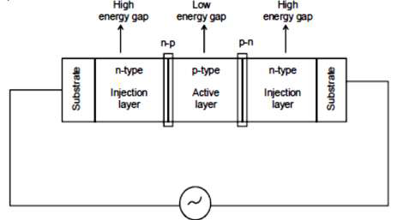
Structure of ILD
Structure of Double Hetro Junction Laser

Slide 42
It uses double hetero junction semi conductors. There are three layers, one is the central active layer and the other two are the two adjacent layers. Active layer is of p-type material, usually Ga(1-y)Aly As of thickness 0.1 to 0.3 μm and of low energy band gap.
The adjacent layers are made up of n-type Ga(1-x)AlxAs of high energy band gap.
Here x is not equal to y and they determine the band gap of alloys.
The adjacent layers are also known as injection layers/confinement layers, (Fig

Slide 43
Working of ILD
When drive current (I) is given to ILD, the excess electrons are moved from Ec of adjacent layer to Ec of active layer in order to achieve population inversion, a necessary condition to be satisfied for laser action to start.
Electron transition occurs in the active layer from Ec to Ev, since only less energy has to be crossed in the active layer.
The photon released in the active layer moves and gets totally internally reflected on hitting the n-p and p-n junction, since n1 > n2. Number of times it gets amplified and finally it results in the emission of light in 800 - 900 nm wavelength range, (Fig).

Slide 44
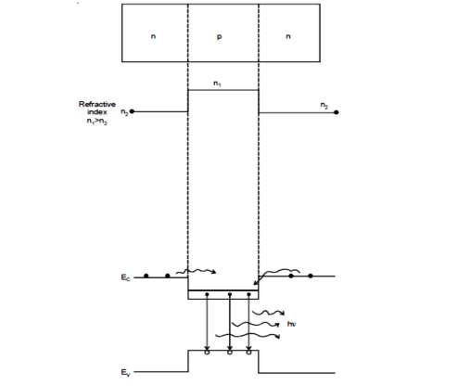
Fig. Working of ILD

Slide 45
Merits and Demerits of ILD
Merits of ILD
Demerits of ILD
High directivity, coherent radiation, monochromatic, high output power.
Acts as narrow spectral width source.
Coupling efficiency is high hence used to couple laser light into the optical fiber.
Used for long distance optical communication at higher bit rate > 200 Mb / sec.
Reduces chromatic dispersion.
Shorter life time; 10 times expensive than LEDS.
Wavelength of the output laser light is governed by the semiconductor band gap.
More temperature dependent.
In order to maintain population inversion, high power consumption is needed and it consequently increases the temperature of the laser.
Due to increase in temperature, (i) Efficiency of the laser decreases rapidly as the electron populations are smeared out through the wide band structure of available states. (ii) As the threshold (J) current density depends on temperature, J also increases consequently.

Slide 46
QUANTUM CASCADE LASER (QCL)
It is basically an Injection Laser Diode (ILD), where the bulk semiconductor is replaced by the nanostructured Multiple Quantum Wells(MQW) that act as the active medium and emit laser light in the Infra red (IR) and in far IR region of the electromagnetic spectrum.

Slide 47
Working of QCL
The structure of QCL is the similar to that of ILD, with the change that n-p-n semiconductors are nanostructured (refer the diagrams of ILD). Initially QWs of slightly different band width and hence different energy states are chosen similar to that as in ILD.
In QCL, when drive current is applied, the electrons cascade down a series of steps emitting a sequence of phonons - quantum of lattice vibrations, hence the name Quantum Cascade Laser Fig.(a) & (b).

Slide 48
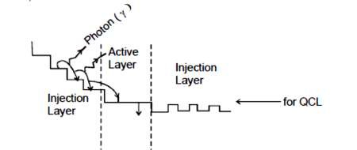
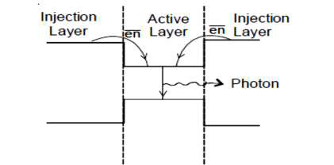
Injection laser Diode
Quantum Cascade Laser

Slide 49
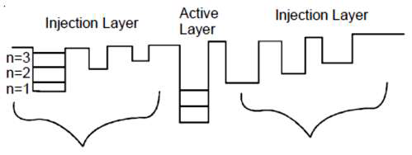
Energy levels of QCL, before the application of bias voltage is shown below
Energy levels of QCL, before the application of bias voltage

Slide 50
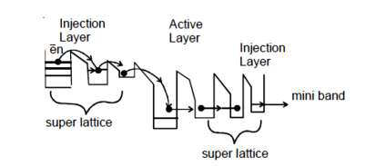
Energy levels of QCL, after the application of bias voltage

Slide 51
Differences between injection laser diode and quantum lasers
ILD | QCL/QWL
Active medium - bulk semiconductors. | Active medium - nano structured semiconductors.
Size of the active medium -0.1 to 0.3μm | 50Å - 100Å
Active region behaves as a 3D box | Active region behaves as a 2D thin film.
Electrons / holes spread over wide energy range with small DOS at the Band gap edge. | Electron‟s energy is spread over a small range with increased DOS at the band gap edge.
DOS depend on the energy of the electron | DOS is independent on energy ofelectron.

Slide 52
Thershold current density is 800A/cm2 | Here is is 60 A/cm2 -which is easy toobtain at room temperature itself.
Output wavelength is governed by semiconductor band gap hence control of output wavelength is not possible. | Output wavelength depends on Thicknesso f nano structured Semiconductor hence precise required wavelength of light can be made to be emitted.
High power consumption, more temperature dependant. | Reduced operating current and are less temperature sensitive.
Downward transition from conduction band to valence band leads to emission of laser light – inter band device. | Downward transition between conduction band states of different confined QWs – intra band device.
They are inter band biploar device. | They are intra band unipolar device

